Slide 1



GLOBAL MUSIC TRENDS 2024
A Cross-Platform Analysis of Spotify Streams and YouTube Engagement
MSBA-285 CAPSTONE PROJECT I
Eberhardt school of Business
University of the Pacific
Stockton, California
Instructor: Dylan Bernardi
Nguyen My San

Slide 2
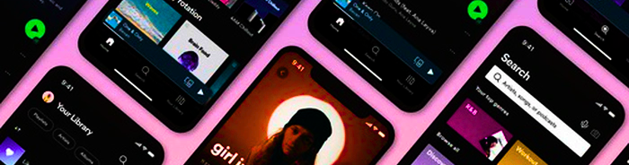

What is Spotify?
Spotify is a digital music, podcast, and video streaming service.
Founded in 2006 in Sweden by Daniel Ek & Martin Lorentzon.
Released globally in 2008.
Allows users to access millions of songs instantly on any device.

Slide 3
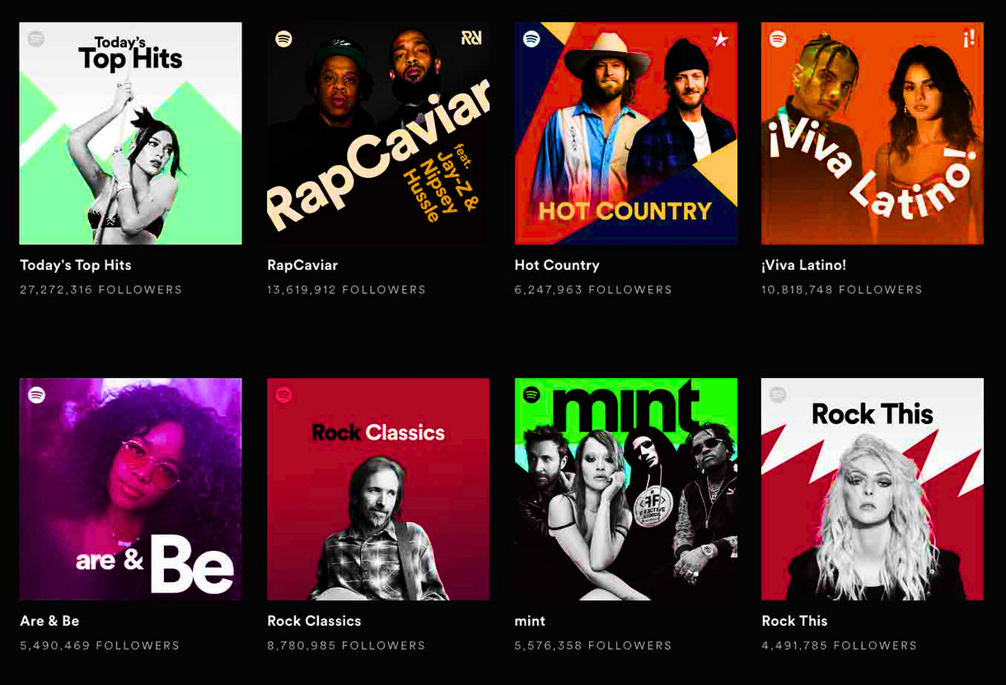
Why Spotify is popular?
Easy access to a massive music library.
Personalized music recommendations.
Curated playlists for every mood.
Works across phone, laptop, tablet,
smart speakers, cars.
Offers both free and premium options.

Slide 4


Spotify in Numbers (2024)
2136M+
600M+
Paid Premium Subscribers
Monthly Active Users
180+
100M+
Countries
Tracks

Slide 5
Project Overview
This project analyzes a Spotify dataset with 1,527 artists and 3,401 tracks.
The goal is to understand music trends, popularity patterns, and cross-platform engagement.
The dashboard explores Spotify Streams, Shazam Counts, YouTube Likes, and Popularity Scores.
Visualizations were built in Grafana and data processed using SQL / BigQuery.

Slide 6
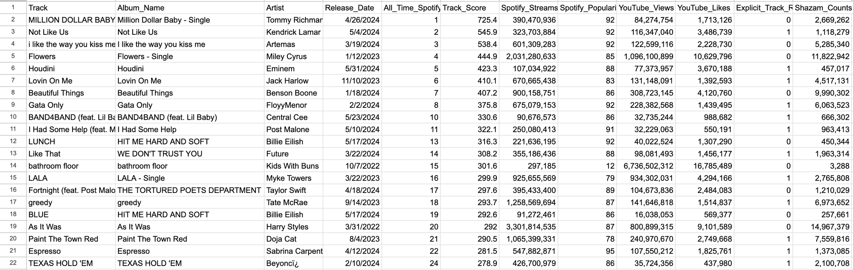
Dataset Summary
Key information about the dataset:
Total artists: 1,527
Total tracks: 3,401
Date range: 1987 – 2024
Contains features such as:
Spotify streams, YouTube views & likes
Shazam counts, Track popularity score
Artist name,Track name,Release year

Slide 7
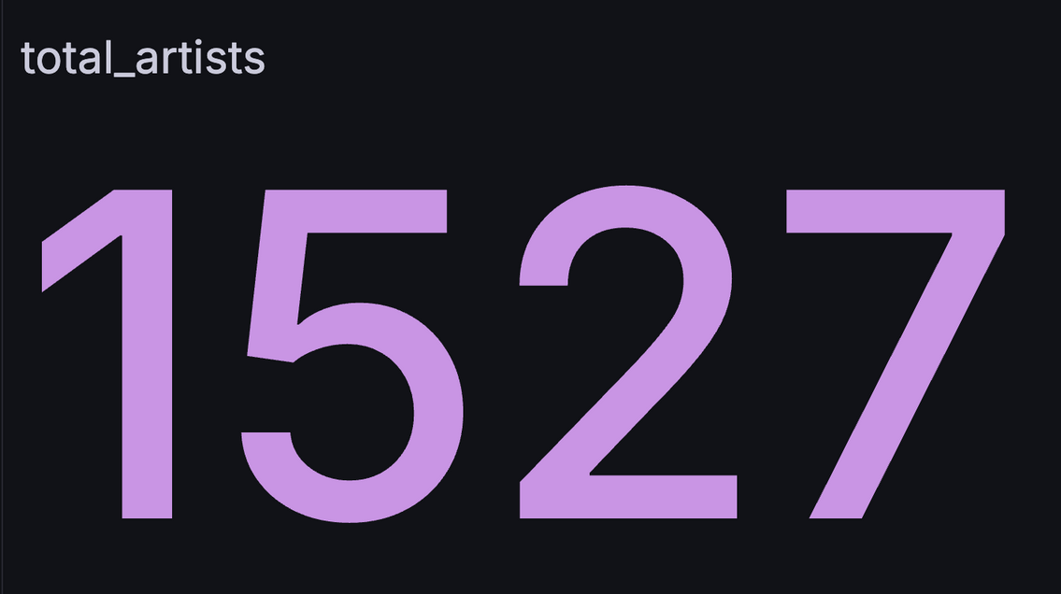
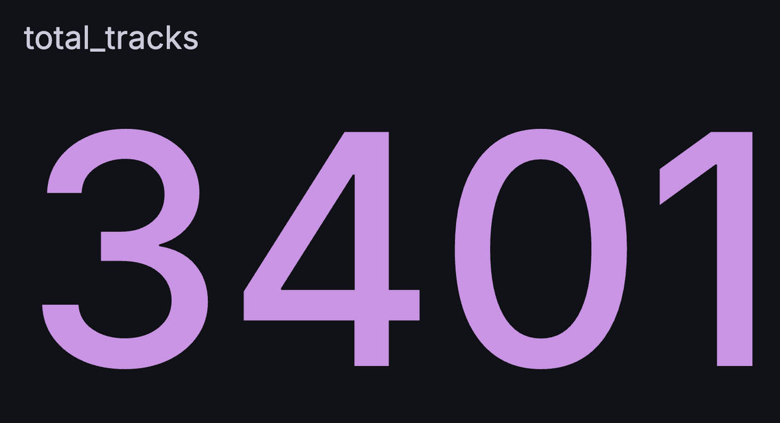
Total Artists & Tracks
Shows the size and diversity of the dataset.
Helps understand how many artists and songs contribute to streaming trends.
Large dataset more reliable trend insights.

Slide 8
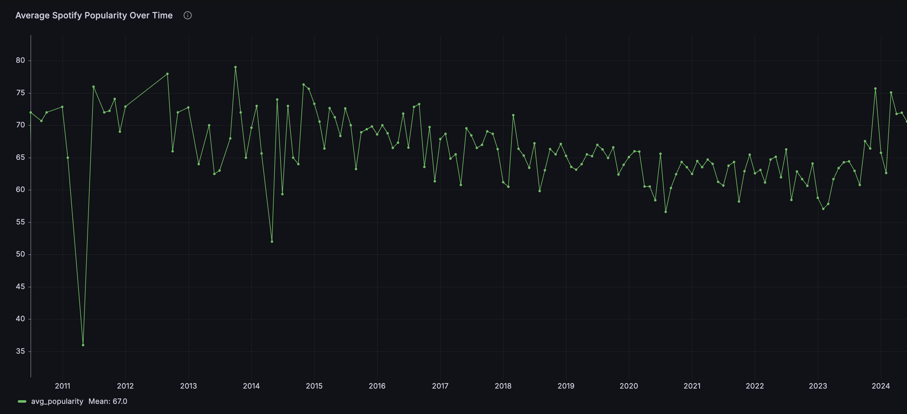
Average Spotify Popularity Over Time
Spotify popularity is influenced by Genre Trends, Viral Moments, and Artist breakthroughs.

Slide 9
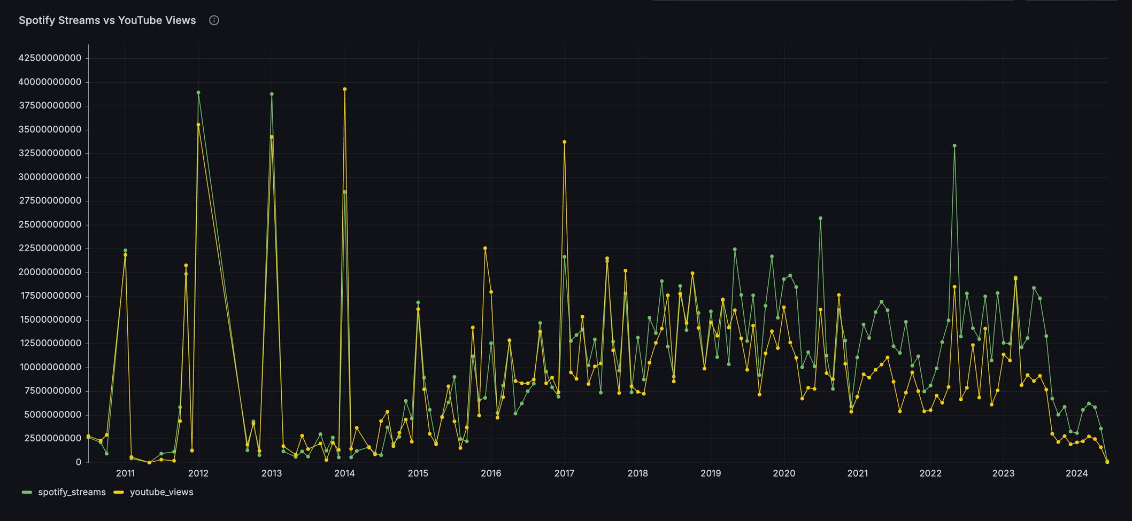
Spotify Streams vs. YouTube Views (Trend Chart)
The pattern suggests that YouTube captures short-term virality, whereas Spotify reflects long-term listening and sustained audience engagement.

Slide 10
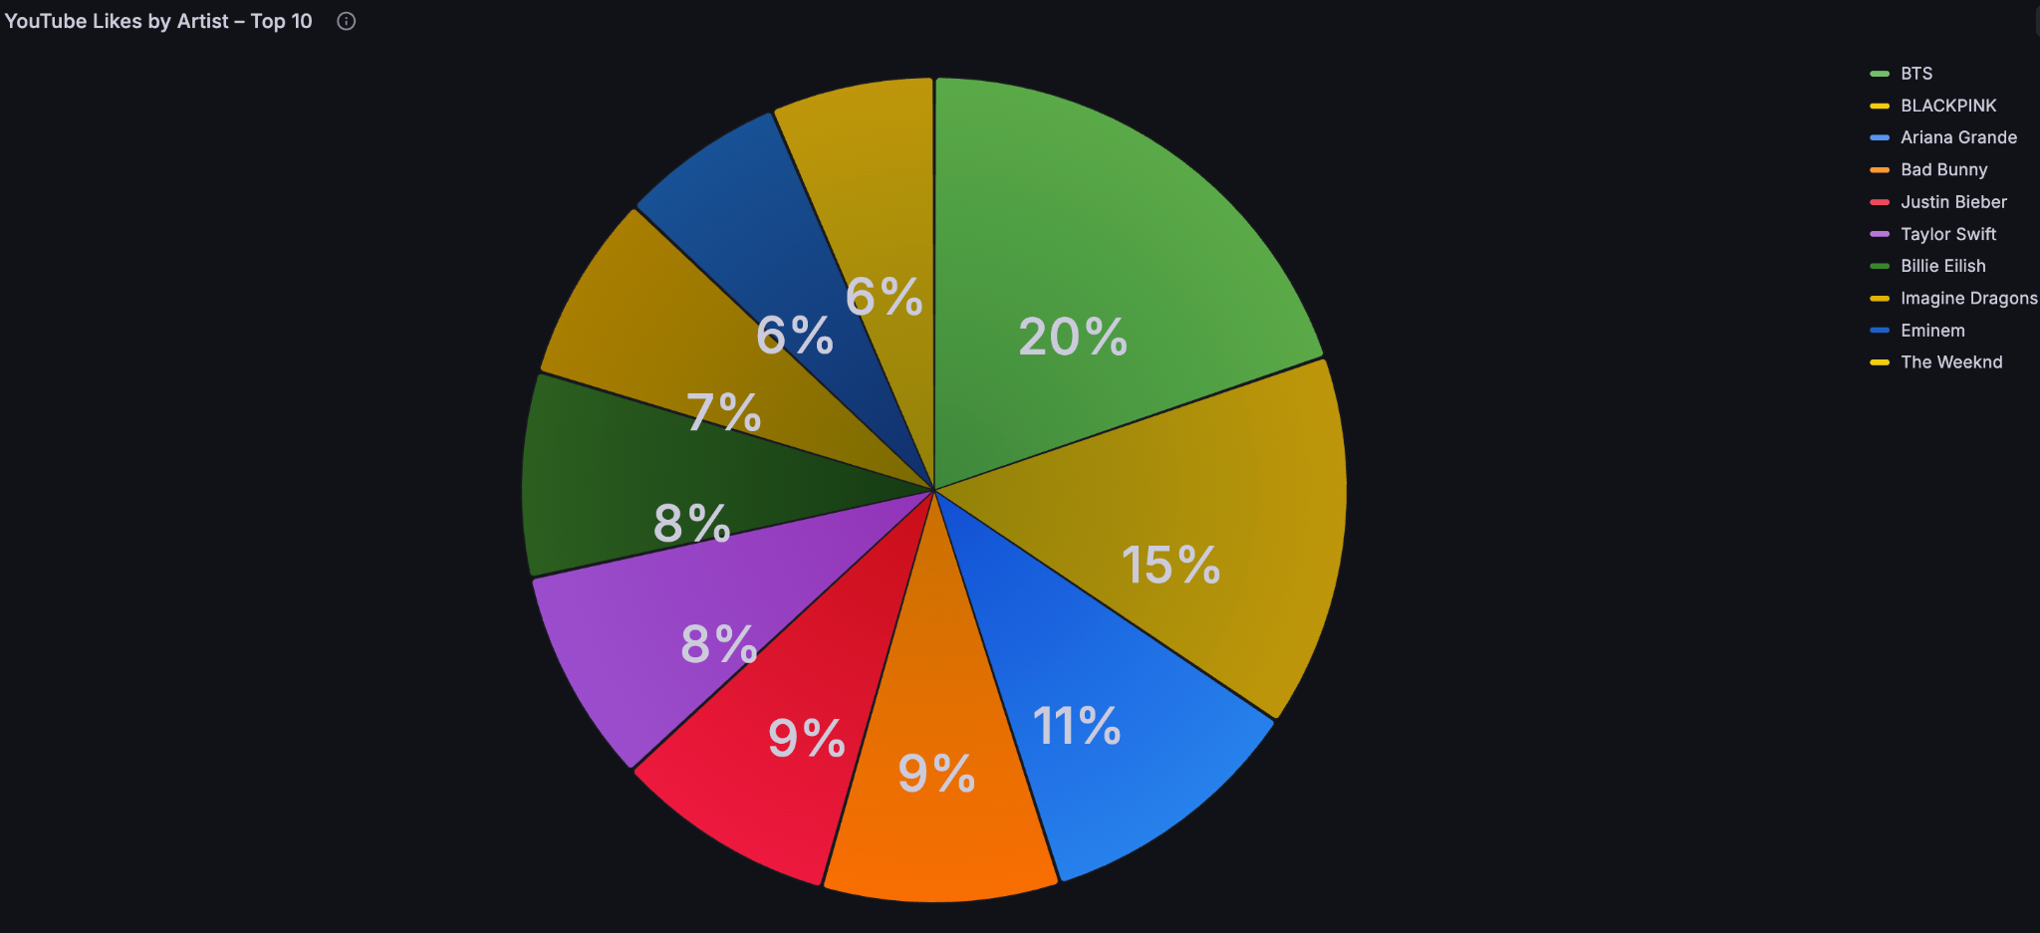
YouTube Likes by Artist – Top 10
The chart highlights which Artists have the Most Active Fan Engagement on YouTube.

Slide 11
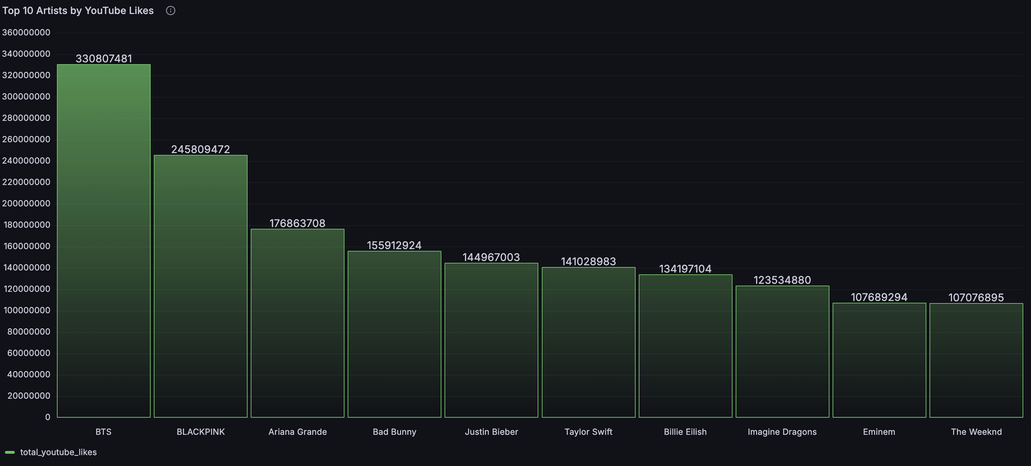
Top Artists by YouTube Likes
Top 5:
BTS – 330M likes , BLACKPINK – 245M, Ariana Grande – 176M, Bad Bunny – 155M, Justin Bieber – 144M

Slide 12
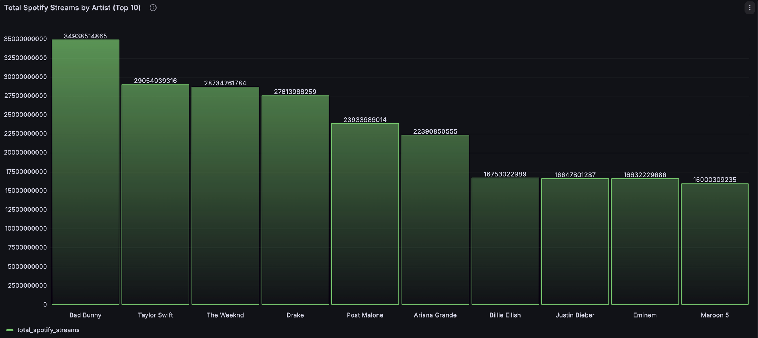
Total Spotify Streams by Artist (Top 10)
Total Spotify Streams: 16,687,430,33245+
Top Artists by Streams: BTS , Taylor Swift, The Weeknd, Drake, Post Malone, Ariana Grande, Billie Eilish, Justin Bieber, Eminem, Maroon 5.
Key Takeaway: K-pop and major U.S. pop artists dominate global streaming.

Slide 13
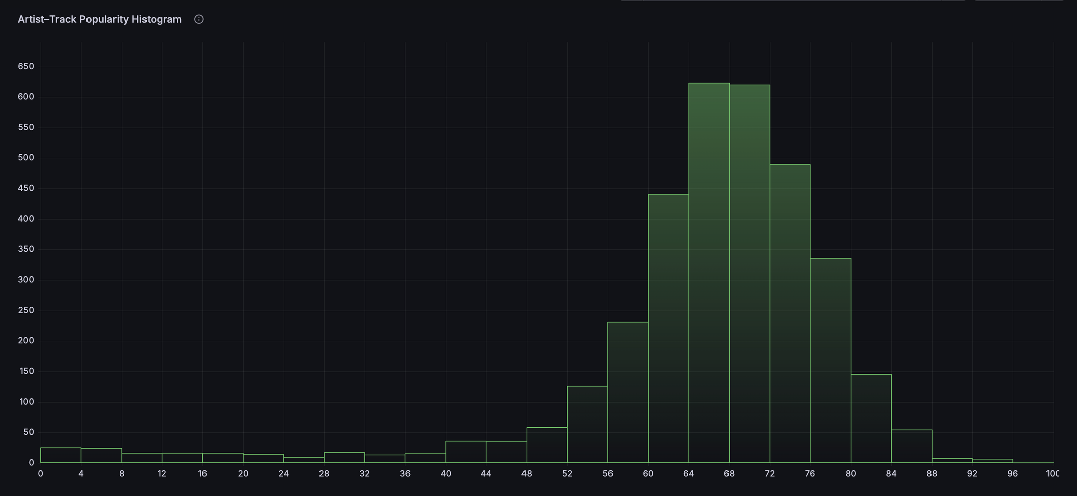
Artist–Track Popularity Histogram
This indicates that the majority of tracks have moderate to high popularity, while extremely low- or high-popularity songs are rare.

Slide 14
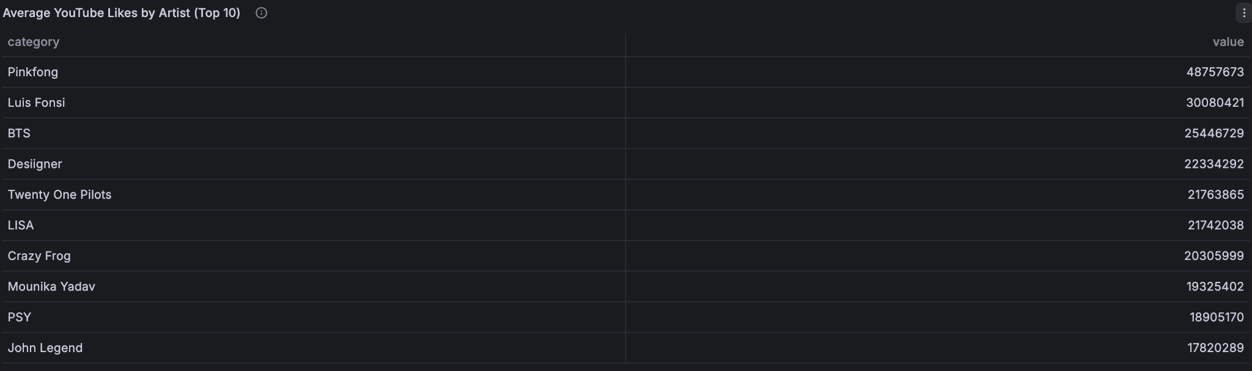
Average YouTube Likes by Artist (Top 10)
Pinkfong ranks #1 with the highest average YouTube likes, driven by viral content.
Luis Fonsi and BTS follow with strong global engagement.
All top artists consistently surpass billions of streams, highlighting their major influence on the Spotify platform.

Slide 15
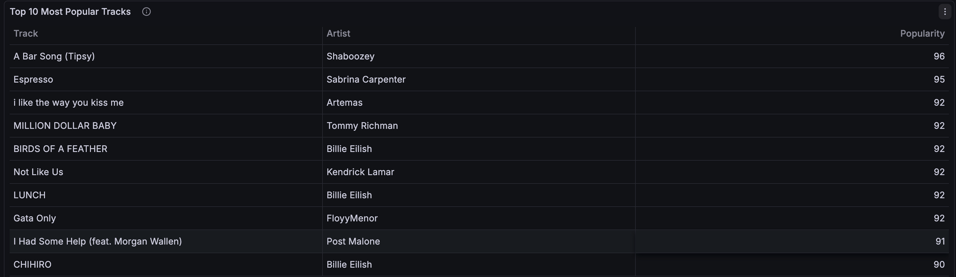
Top 10 Most Popular Tracks From Spotify
The Top 10 Most Popular Tracks show that artists like Shaboozey, Sabrina Carpenter, Billie Eilish, and Kendrick Lamar dominate listener engagement with the highest popularity scores.
This table highlights the top-ranked songs based on Spotify popularity scores. A Bar Song (Tipsy) by Shaboozey leads with the highest score of 96, followed closely by Sabrina Carpenter’s Espresso at 95.

Slide 16
Top 10 Most Popular Tracks From Spotify
The Top 10 Most Popular Tracks show that artists like Shaboozey, Sabrina Carpenter, Billie Eilish, and Kendrick Lamar dominate listener engagement with the highest popularity scores.
This table highlights the top-ranked songs based on Spotify popularity scores. A Bar Song (Tipsy) by Shaboozey leads with the highest score of 96, followed closely by Sabrina Carpenter’s Espresso at 95.

Slide 17
Key Findings
Spotify popularity is stable but influenced by industry trends.
Strong correlation between Shazam searches, Spotify streams, and YouTube views.
BTS, BLACKPINK, Ariana Grande, Billie Eilish, and Taylor Swift dominate across metrics.
YouTube activity is a strong predictor of Spotify performance.
Streaming behavior reflects global fan culture and digital consumption patterns.

Slide 18
Conclusion
This project demonstrates how multi-platform metrics help analyze artist success.
Spotify and YouTube provide valuable insights into listener engagement.
Trend analysis helps predict future popularity patterns.
The dashboard provides a powerful visualization tool for understanding digital music consumption.

Slide 19

Thank You

